Slide 1
The leading platform of peer-reviewed scholarly literature

Slide 2

  History of Elsevier
  ScienceDirect
  Search Tips
  New Features
  Q & A

Slide 3


History of Elsevier
Notes:
爱思唯尔提供信息和分析，帮助机构和专业人员促进科学进步，医疗保健，服务人类进步。

Slide 4


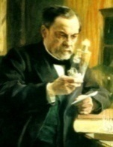
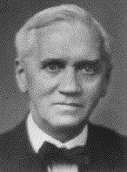





History of Elsevier
Marie Curie
(Physics, Chemistry)
Louis
Pasteur
(Chemistry)
Alexander Fleming
(Medicine)
Albert Einstein (Physics)
John C. Mather (Physics)
Craig C Mello (Medicine)
Shinya
Yamanaka
(Medicine)
Francoise
Barre-Sinoussi
(Medicine)
Galileo’s last and greatest work, published in 1638 by Elzevir, Discorsi e Dimostrazioni Matematiche
Notes:
Our customers are doing momentous things, and we are uniquely positioned to show our customers the ‘art of the possible’.
For more than 130 years we have shared their commitment to transforming and advancing science, health and technology. We understand the worlds in which clinicians, educators, and academic and corporate researchers work, the outcomes they want to achieve and the challenges they face in achieving them. (Pictures are some of the Nobel Laureates publishing in our journals).
We have a responsibility to use that understanding to create highly effective solutions that enable our customers to leverage the vast potential of information to advance science, health and technology in ways that they could not do alone, and to anticipate the new ways customers will want to use information in the future. That is what we mean by ‘leading the way’.

Slide 5
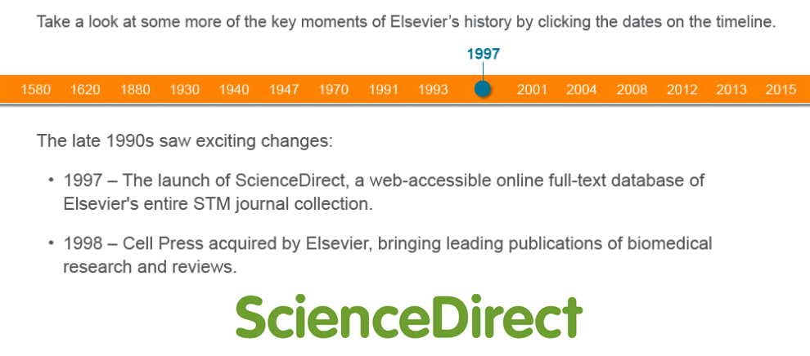
History of Elsevier

Slide 6

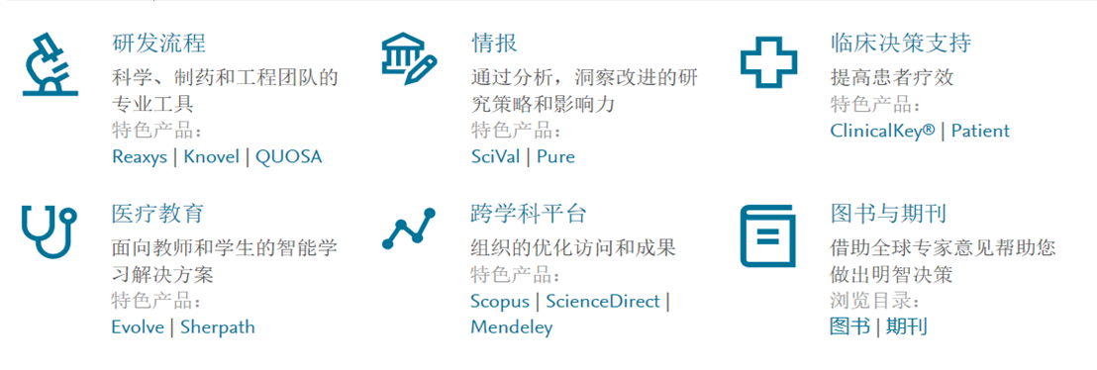
History of Elsevier

Slide 7
  History of Elsevier
  ScienceDirect
  Search Tips
  New Features
  Q & A

Slide 8
ScienceDirect
A ScienceDirect subscription gives you and your patrons access to over:
“ScienceDirect offers an easy to operate
platform that provides convenient access to a broad spectrum of interesting and useful research publications that I may have never considered exploring.”
15 million publications
3,800
journals & serials, representing more than 612,000 issues
37,000
books including reference works
—Researcher/ Staff Member Life Sciences, USA
Digital archives reaching back as far as 1823

Slide 9
Access to books and journals on one platform provides more meaningful insights
Every DAY, ScienceDirect researchers access an average of:
90%
of surveyed users agree that in their work they often use books and journals together
4 Million
Books and journals were used together in the same research session in 2017
79,226
book chapters
(11,976 books)
&
1,230,022
journal articles
(3,857 journals)
Source: TechValidate survey of 267 users of Elsevier ScienceDirect Books.
TVID: 39C-DC2-A29

Slide 10
Researchers agree using ScienceDirect positively impacts their research activities…
88%
84%
“ScienceDirect is an engine for researching papers which complies with all academic expectations. I have been researching papers on ScienceDirect since 1998 when I started my PhD in the UK and I am still using it.”
…saves me time
…has particular strengths
in my field of specialization
84%
85%
…makes my research
activities more successful
…helps me discover research
so I am fully informed
—Researcher/ Staff Member
Chemistry, Engineering, Env. Sciences, Brazil
Sample: ScienceDirect users (n=2,071)
Q: For each of the following statements, please indicate how much you agree or disagree that the statement applies to ScienceDirect. (% Strongly Agree + Agree + Slightly Agree)

Slide 11
ScienceDirect is consistently attracting more global content
Elsevier Published Articles (‘000)
419
436
400
365
380
321
336
284
295
297
258
267
+5% CAGR
2006
2007
2008
2009
2010
2011
2012
2013
2014
2015
2016
2017

Slide 12
Our journals are ranking highly in every field
Journal ranking—Citescore
Journal ranking—Impact Factor
Share of top–10% journals
Subjects with top rank
(All Science Journal Classification)
Share of top–10% journals
Subjects with top rank
(Journal Citation Reports)
107
29%
75
32%
14%
12%
34
15%
30
13%
27
27
3%
10
3%
10
Elsevier
Company A
Company B
Company C
Elsevier
Company A
Company B
Company C
Elsevier
Company A
Company B
Company C
Elsevier
Company A
Company B
Company C
Journal ranking by CiteScore across 330 subjects per Scopus Metrics database; source: Scopus data (2016)
Journal ranking by Journal Impact Factor across 234 subjects per Clarivate’s Journal Citation Reports database; source: Clarivate data (2016)

Slide 13
Top quality content regardless of discipline, size, and type
Share of articles per journal quality tier
Share of articles per journal Field Weighted Citation Impact Tier*
Share of articles in…
30%
Top 10% journal FWCI tier
Higher
quality
Elsevier
10-25% journal FWCI tier
29%
17%
Total
market
60%
13%
Company A
15%
Other
25-50% journal FWCI tier
6%
4%
Company B
Company C
5%
Bottom 50% journal
FWCI tier
Lower quality
*Article share (articles published in 2016) per journal Field Weighted Citation Impact (FWCI) tier.
Field Weighted Citation Impact (FWCI) is calculated on the basis of citations in 2012-16 to articles published in 2012-16 and accounts for article type, publication year and subject field. Source: Scopus data

Slide 14
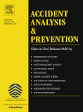
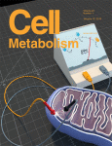
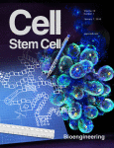
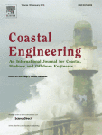
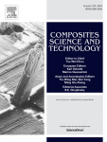
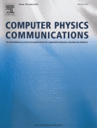
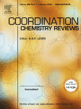
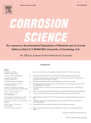
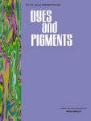
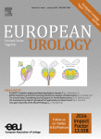


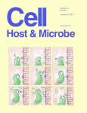
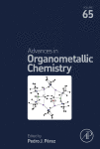
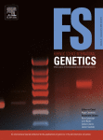
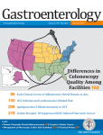
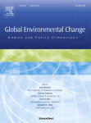
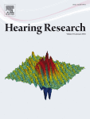
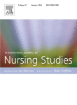
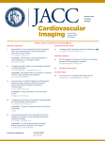
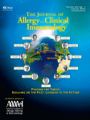
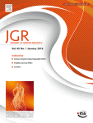
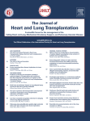
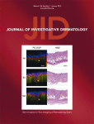
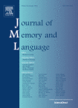
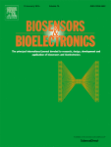
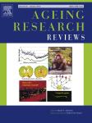

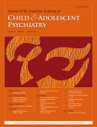
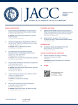

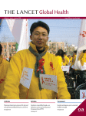
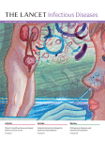
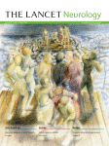
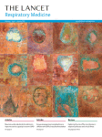
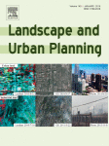
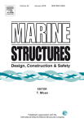
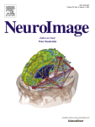
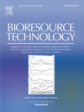
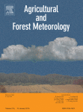
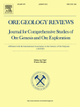
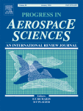
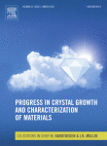
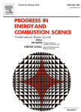
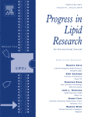
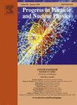
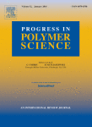
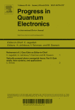
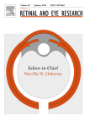
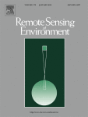












Top Journals in ScienceDirect
2015: No.1 in 71 categories out of 235 *
2014: No.1 in 62 categories out of 232
* Includes one book series Advances in Organometallic Chemistry
Source: Thomson Reuters Journal Citation Reports 2015
Notes:
ScienceDirect* journals that rank No.1 in their subject category (2015)

Slide 15














Top Journals in ScienceDirect
19和20世纪, The Lancet 的目的是为了克服疾病给全球人类带来的困扰，为医疗社区提供高质量的，基于证据的内容。
The Lancet的影响因子是 44.002, 每年在SD上被下载11万次 。
除了每周更新的The Lancet主刊， Lancet系列期刊有10本可订阅期刊以及三本完全公开获取的期刊。
2017年，我们创刊第14本期刊，名为：The Lancet Child & Adolescent Health.

Slide 16
  History of Elsevier
  ScienceDirect
  Search Tips
  New Features
  Q & A

Slide 17


























fishery
简单检索
高级检索

Slide 18


简单检索

Slide 19


简单检索

Slide 20

简单检索

Slide 21



简单检索

Slide 22
高级检索

Slide 23

高级检索
fisheries research
2018
management

Slide 24


高级检索

Slide 25

高级检索

Slide 26

高级检索

Slide 27


个人账号

Slide 28

个人账号

Slide 29

个人账号

Slide 30

个人账号

Slide 31




ScienceDirect invests continually to ensure continuous optimization and meet the most vigorous standards
We focus on 3 key areas to ensure the best possible customer experience:
Better performance
Optimized architecture for journal homepages ensures pages load within 1 second
100% results
The most relevant information is prioritized (latest articles and issues, articles in press, special issues, alerts and journal information)
Ease of use
A modern and clean look on any screen size with each journal instantly recognizable to the user thanks to custom colors

Slide 32


手机检索
Then (1997)
Now (2018)

Slide 33

手机检索

Slide 34


手机检索
发文量最高期刊

Slide 35


手机检索

Slide 36
  History of Elsevier
  ScienceDirect
  Search Tips
  New Features
  Q & A

Slide 37

We look at how users use content today and will want to use it in the future
基于用户行为，我们发现研究人员的工作流程变得：
更复杂
跨学科
广泛使用多类型内容
Notes:
Based on our collection of user behavior data and detailed user research , we know that a researcher’s workflow has become more complex than ever.
Not only has it become more interdisciplinary, but the user now covers a wider range of content during each research session
We also found that finding the most relevant content is becoming more difficult

Slide 38
Researchers have pressing need to get up-to-speed in new fields and disciplines
为了创新，科研人员必须建立跨学科的联系
全球有44%的科研人员每周至少有一次是在 搜寻非直接研究领域的内容
科研人员通过查看期刊文章、参考资料、文献选集、图书以及在线资源，快速进入不熟悉领域进行研究
Frequency of searching for content outside field of immediate study*
检索非直接研究领域文献的频率*
每周几次
每周一次
每月一两次
每2-3月1次
每6个月1次
几乎从不
取决于当时研究的课题
*Research carried out by RAP for Research and Academic Relations, Feb / March 2015
Notes:
Interdisciplinary or multi-disciplinary research is a growing trend and challenge for our users – and Researchers have a pressing need to get up-to-speed quickly in new fields and disciplines
Some facts:
Globally, 46% of researchers are looking outside their immediate field more than once a work
20% of researchers are doing this several times a week
Each year, 46% of researchers look to work with collaborators outside their discipline
Interdisciplinary work involves new subjects, unexpected processes and dense jargon, forcing researchers onto unfamiliar terrain

Slide 39



ScienceDirect Topics helps researchers uncover critical and contextual information within their workflow
1
2
用分类法整合图书和期刊内容，链接概念和关联
通过机器学习和自然语言处理来理解上下文、含义、相关性
在全文文献中进行模式匹配，确认内容类型和“使用案例”
创建全文“片段”的动态自由层，使文献更易被搜索引擎发现
3
*When a short definition is not available, the longer definition can be found in Book excerpts

Slide 40

ScienceDirect Topics
Definitions extracted from Elsevier books.
从爱思唯尔图书中提取的
定义
Related terms with hyperlinks to explore.
链接到相关术语进行深入
探索
Short extracts of the most relevant information that are often found deep within book chapters and links to the source books for further exploration.
摘录最相关的信息，从图书
章节中深度挖掘，并链接到
来源图书，以便做进一步的
研究
4. Discoverable through
search engines and free
to access.
可通过搜索引擎发现并免费
访问。
1
1
2
2
3
3
Notes:
ScienceDirect Topics currently have 4 features – for each topic page – of which we currently have 80,000:
Definitions extracted from Elsevier books.
Related terms with hyperlinks to explore.
Short extracts of the most relevant information that are often found deep within book chapters and links to the source books for further exploration.
Discoverable through search engines and free to access.
This is a free feature – if you want to engage users it helps if it’s free

Slide 41


ScienceDirect Topics
https://www.sciencedirect.com/topics

Slide 42


Slide 43



ScienceDirect and Open Access

Slide 44
ScienceDirect and Open Access
Gold open access
Leading gold open access publisher
Publish over 170 fully open access journals
Publish over 1,850 hybrid journals
Published over 25,000 open access articles in 2016
Choice of either a commercial (CC BY) or
non-commercial (CC-BY-NC-ND) user license
Article publishing charges (APCs) range from
$150 - $5000 (US Dollars)
Green open access
Largest publisher enabler of green open access
All 2500+ journals provide a green open access option
Participate in CHORUS and support pilots with institutions and international funders
Free API program to fuel repositories
Share link service provides 50 days free access to recently published research
Open archives in 108 journals, including Cell Press titles after 12 months

Slide 45
  History of Elsevier
  ScienceDirect
  Search Tips
  New Features
  Q & A

Slide 46



Thank you & Let’s Stay in Touch !
Facebook
/Elsevier.ScienceDirect
Twitter
@ScienceDirect

